Slide 1
CorpTech Technology Classification System
High
Technology
18 industry categories
Roughly 260 major product categories
Over 3000 high technology product/services

Slide 3
Granularity of CorpTech Classification System
AUT
FM flexible manu. sys.
MC manu. Control sys.
MH mat. handling eqt.
MV machine vision sys.
RO robotics eqt.
SV services
SUB
MAN
SE semiconductors/ devices
SV services
EP electronic & photonic manu. eqt.
COM
SIC 7372
prepackaged software
NAICS
511210
software publishers
ENV
CP control eqt.
CB computer bds
TR terminals
SV services
TEL
CN converters
SP specialized computers
IF Internet trans./ security sv.
SV services
TAM
TD distribution eqt.
EM electronic mail eqt.
NW network/Internet eqt.
TE telephone/voice eqt.
ZD other data com. eqt.
AN analyzers
SOF
SC scientific lab eqt.
AC accounting
AI artificial intell.
BA banking
CS comm. sys
DM database file mgmt.
ED educ./training
FM facilities mgmt.
MA manu
OA office auto
PO soft. dev. sys
PU public utilities
SM sales/marketing
SV services
TS technical/ scientific
UT utility sys
WD warehousing/dist
ZA apps nec
Diagram contrasts industry (SIC and NAICS) with a company and product classification system (CorpTech). Lowell MA area companies in SIC 7372 and NAICS 511210 industry codes (center box) make products in 8 CorpTech major technology codes and 39 second-level product codes. Product codes in the perimeter boxes indicates major product of at least one Lowell area SIC 7372 company; product codes below the boxes represent secondary products for Lowell area SIC 7372 companies. Lowell area refers to Lowell, Chelmsford, and Westford townships.

Slide 4
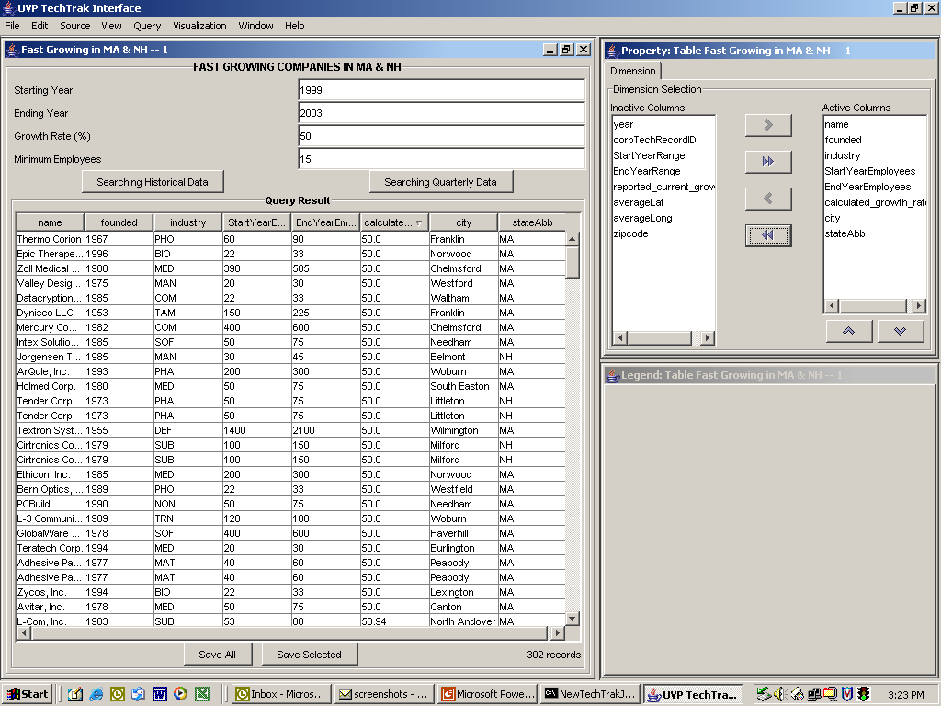
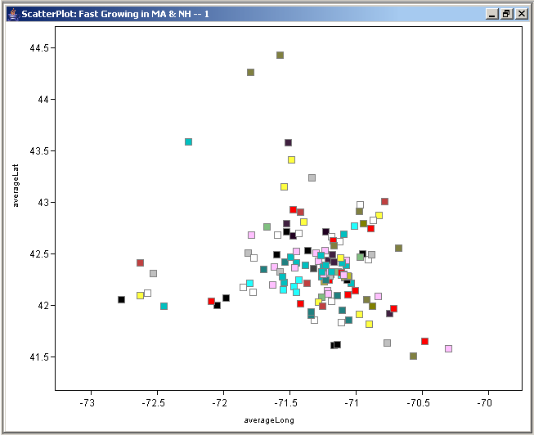

Slide 5
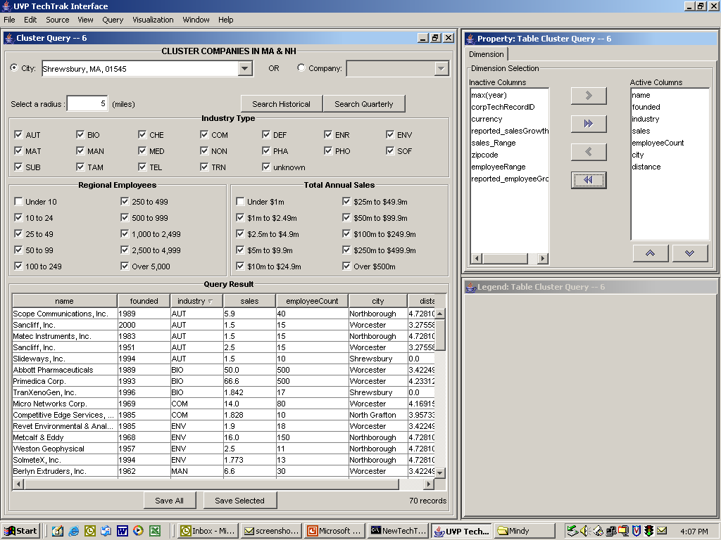

Slide 6
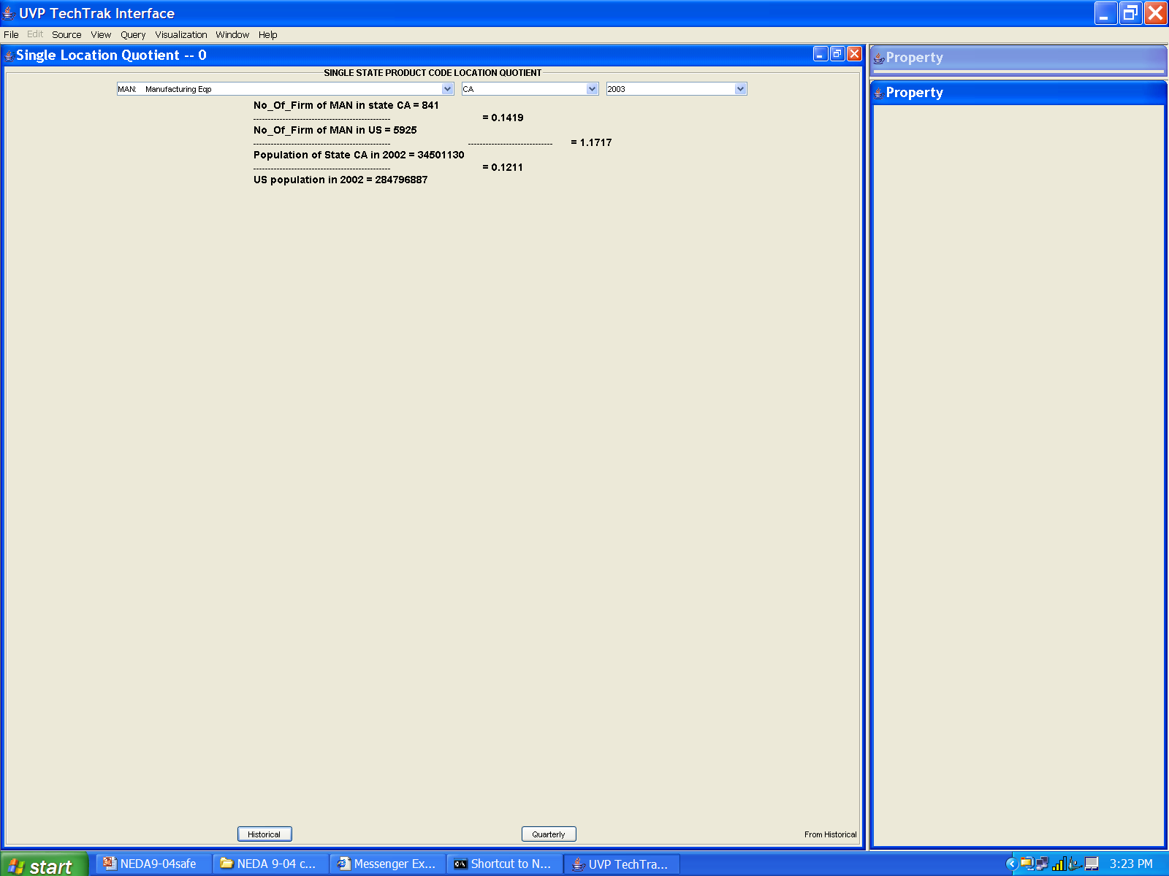

Slide 7
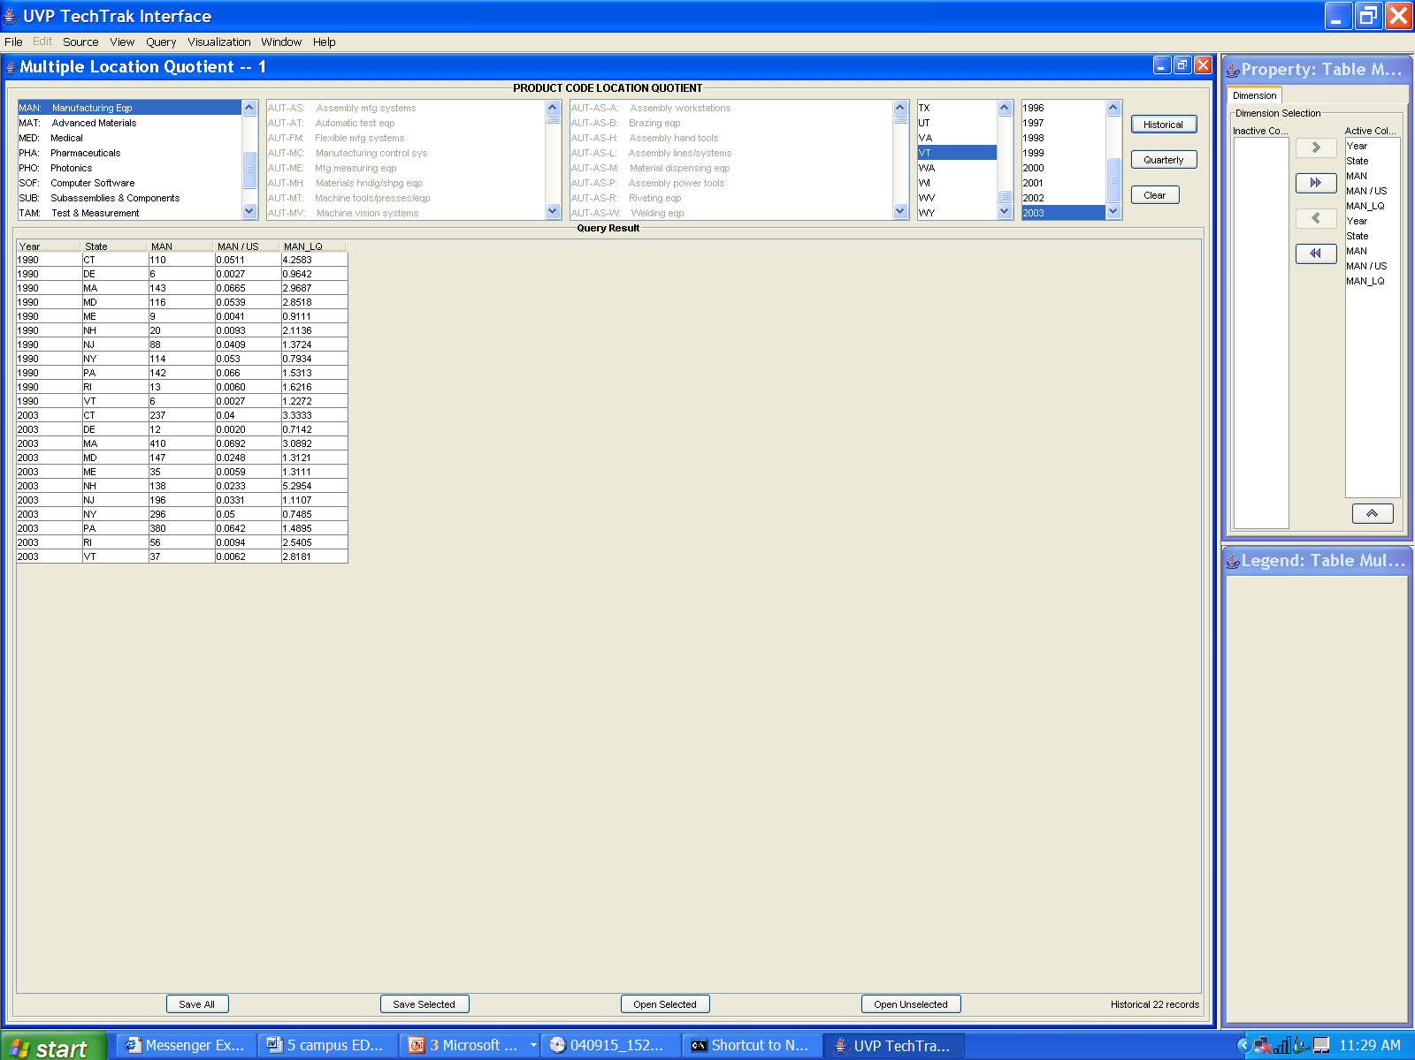

Slide 8
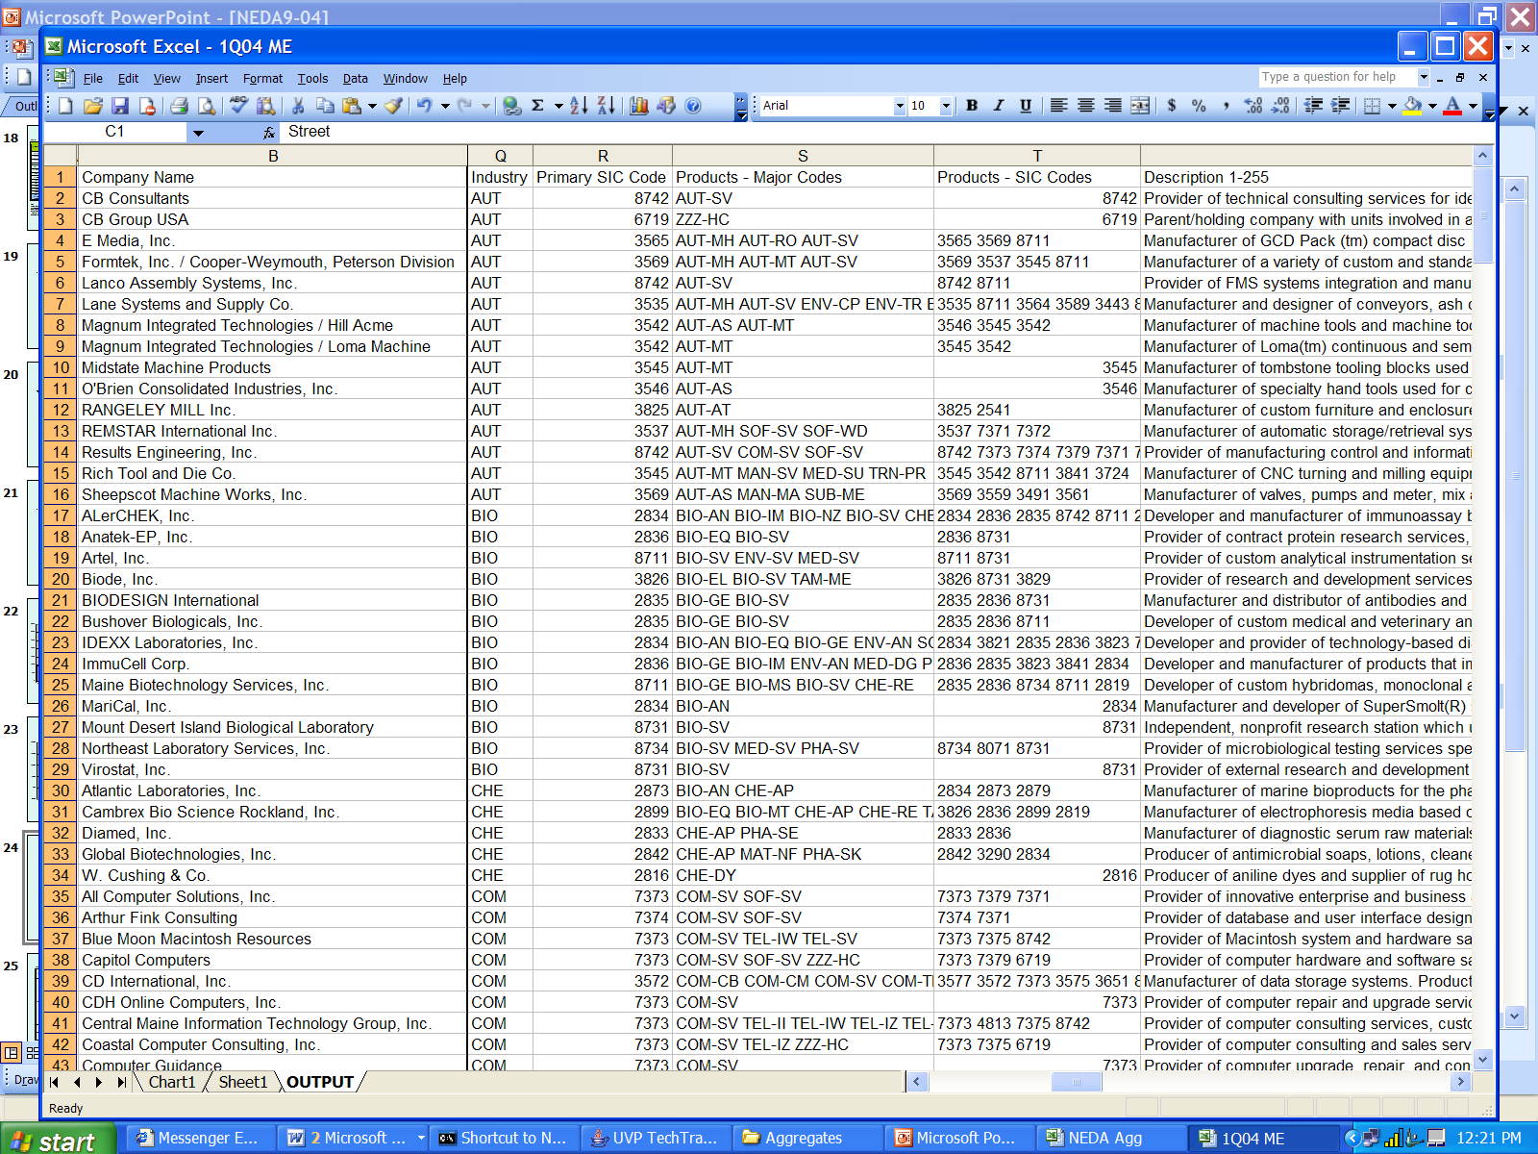

Slide 9
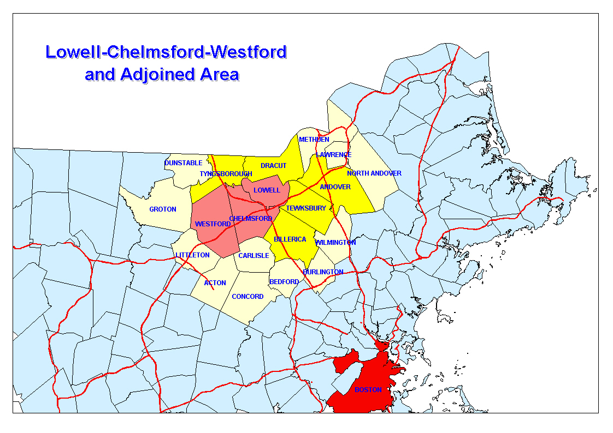
The Lowell Area: Merrimack Valley, Massachusetts

Slide 10
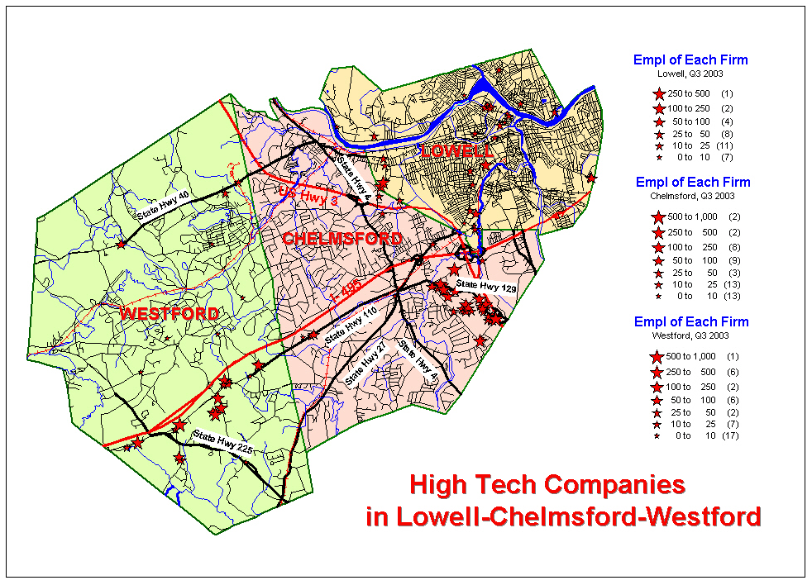

Anticipating Technology Trends Group

Slide 11
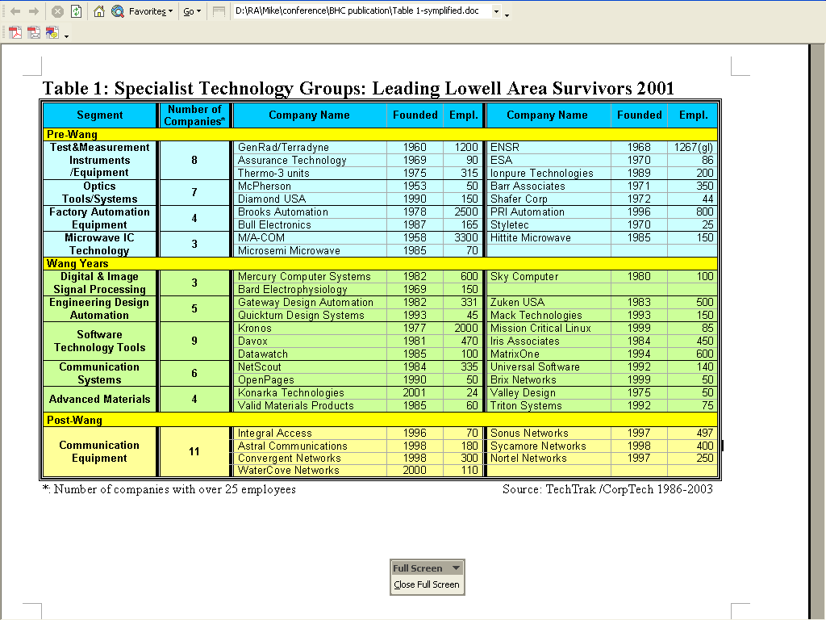

Slide 13
Telecom Industry Churn

Slide 14
Anticipating Technology Trends
A Proactive Approach to Regional Economic Development
Product Diversification of the Cascade “Family of Companies”

Slide 15
Lowell Area Companies: Foreign Investment

Slide 16
MED Companies in MA (4thQ04)
282 operating units
177 MED industry code (captured by SIC)
105 non-MED industry code; MED product
63 with > 200 EEs (32 are MED cos.)
17 pre-1950s
28 1960s and 1970s
64 1980s
50 1990s
12 2000s

Slide 17
Enterprise Location Quotients: MED
 |  |  | CA | MN | MA | NJ
1990 |  |  | 1.2 | 3.4 | 3.5 | 2.6
1995 |  |  | 1.3 | 2.9 | 3.5 | 2.2
2000 |  |  | 1.6 | 3 | 4.2 | 2.1
2003 |  |  | 1.6 | 3 | 4.2 | 2

Slide 19
Building an Industry: Entrepreneurial Firms and Regional Technology Development
Fast Growing Big Companies (1000+ee’s)
Fast Growing, Mid-size Independents (200+ees)
Fast Growing, Big MED Acquisitions
Fast Growing, non-MED Cos (200+ees).
Foreign Headquartered Operating Units
Recent Entrants: Large Contract Manufacturing/Services Companies

Slide 20
Fast Growing, Big Medical Device Companies: Employment

Slide 21
Fast-growing, medium-size medical device companies

Slide 22
Fast Growing, Non-MED Companies with Medical Products

Slide 23
Foreign headquartered MED companies located in MA

Slide 26
MA: New Sector Creation (distinctive dynamic regional capability)
Minicomputers
Data Storage Systems (‘file cabinets of IT)
Medical devices (US output grew 9 times in 25 years to 2004; regionally specialized)
Network Switching Equipment
Mutual fund industry (asset management)
Biotech
Business software tools
Robotics
Advanced materials/nanotech
Renewable energies

Slide 27
Boston High Tech Business System
Core Process is the innovation chain:
BR + AR + DR + NPD + TIE → early stage production
Business units not embedded in supply chain networks such as PC industry of Silicon Valley
Business units are embedded in a regional Industry Experiment Laboratory which fosters new sectors
Notes:
Boston’s dynamic of increasing differentiation of enterprise capability is not based on increasingly vertically specialized sectors (as in PC industry of SV). It is based on the capacity to sprout new verticals; here vertical is new or next generation technology combined with new business and sector growth opportunities.

